Slide 1
Deep Learning with CNTK Azure Machine Learning Meetup Oct 26, 2017
Introduction RNN+LSTM
With CNTK
Sources and References at end of deck

Slide 2
Some updates
CNTK 2.2 is released
More C# and java support. More samples. Some API updates.
“R” binding is available: https://github.com/Microsoft/CNTK-R
Gluon developer announcement with Amazon (MXNet and CNTK developer productivity)
Gluon makes it easy for developers to learn, define, debug and then iterate or maintain deep neural networks, allowing developers to build and train their networks quickly.
Symbolic and imperative programming.
Supports sophisticated techniques like dynamic graphs and flexible structures. Support for both symbolic and imperative programming is not found in other toolkits.
Define complex models. Gluon comes with a rich, built-in layers library that significantly simplifies the task of defining complex model architectures through reuse of the pre-built building blocks from the library.
Execution efficiency. Gluon has native support for loops and ragged tensors (batching variable length sequences) which translates into unparalleled execution efficiency for RNN and LSTM models.
Advanced scheduling. While scheduling on a single GPU is easy, doing so on multiple GPUs is far more complex. Through its MXNet or Cognitive Toolkit backends, Gluon offers automatic distribution for both symbolic and imperative mode.

Slide 3
This evening
Intro to RNN and LSTM with CNTK
Files at: https://github.com/jimwill3
Next meetup will be Nov 30
Targeting – overview/demo of the recent preview release of Azure Machine Learning Workbench (this is not Azure ML 2.0!!).

Slide 4
The problem
So far - our demos are based on fixed size samples input (i.e. 28*28 pixels) to output one result (classify an image, place a number on a graph).
Other scenarios require more dynamic inputs and outputs
Predicting what word(s) should be emitted in translating a phrase – the number of words in to words out varies for many of the phrases.
Predicting the best next item in a sequence where earlier information in the sequence is very important
“ I was born in France and I speak fluent …” – predicting French is more likely to be accurate by remembering the France part. Imagine if you tried to predict the next word in “I speak fluent…”
Imagine trying to summarize a movie and forgetting a character killed off in the first 10 minutes.
A basic neural net – even a deep one – has no built in way to represent these things

Slide 5
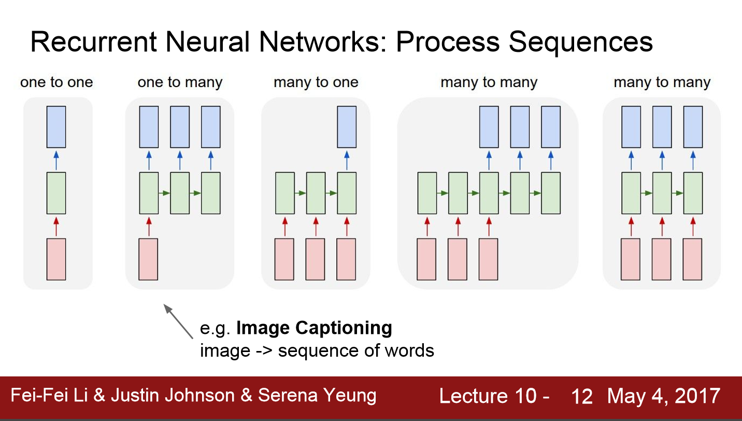
Needed: A richer network design

Slide 6
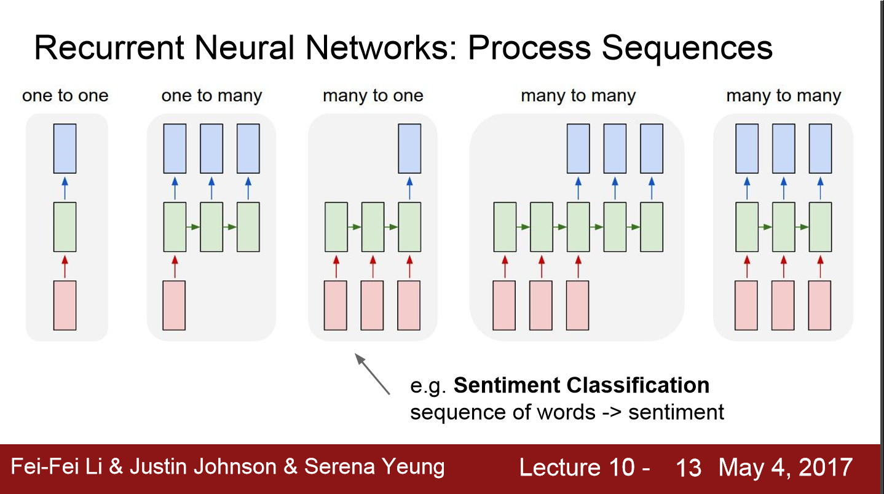
…

Slide 7
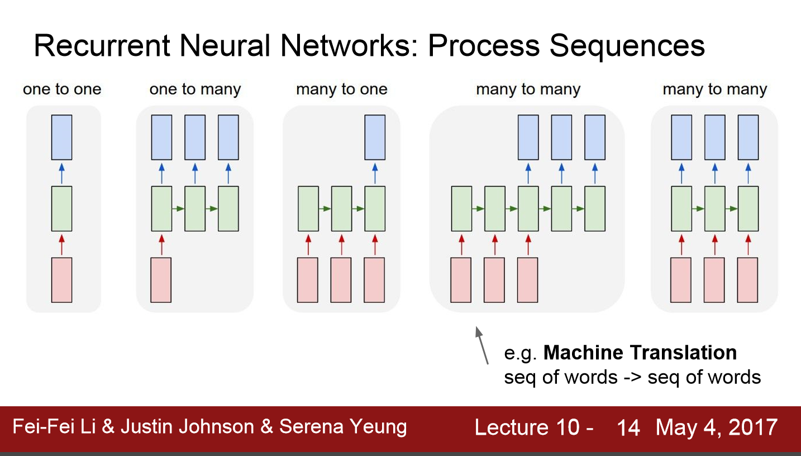
…

Slide 8
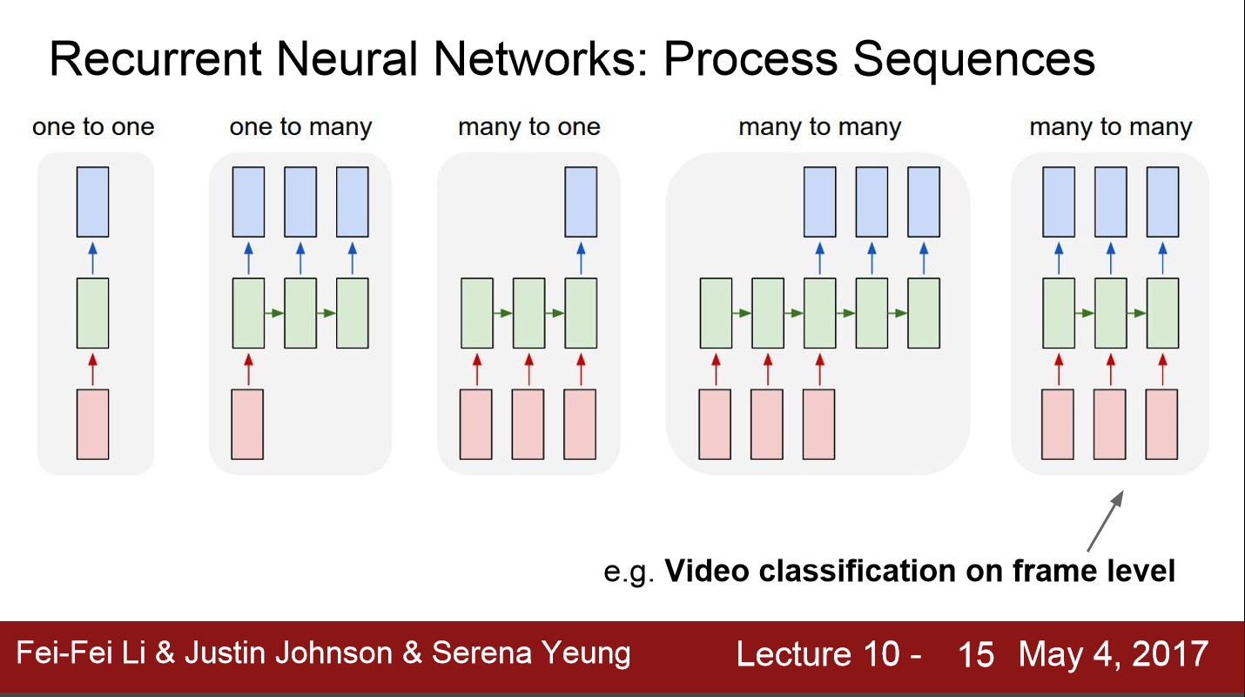
…

Slide 9
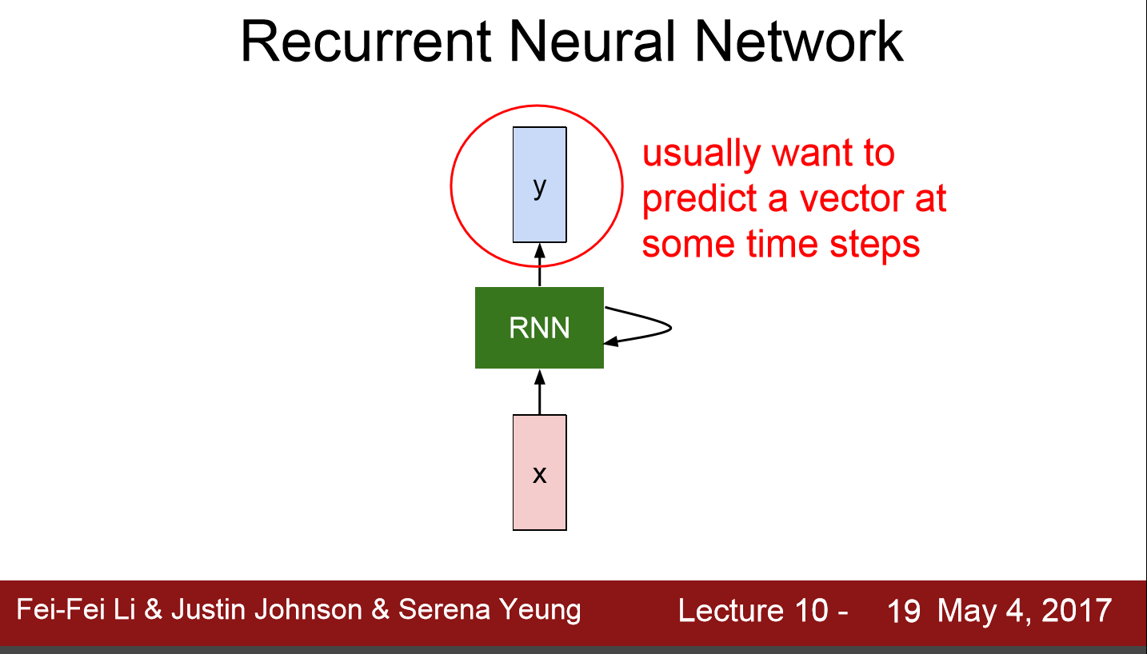
A (limited) feedback

Slide 10
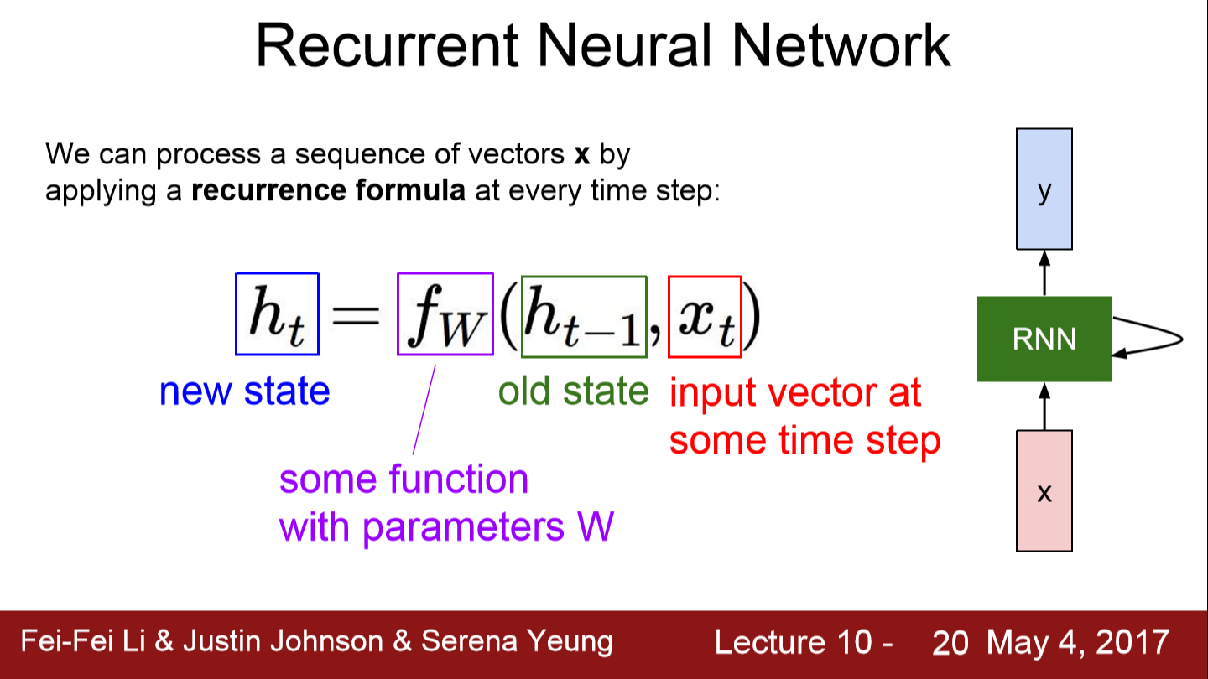

Slide 11
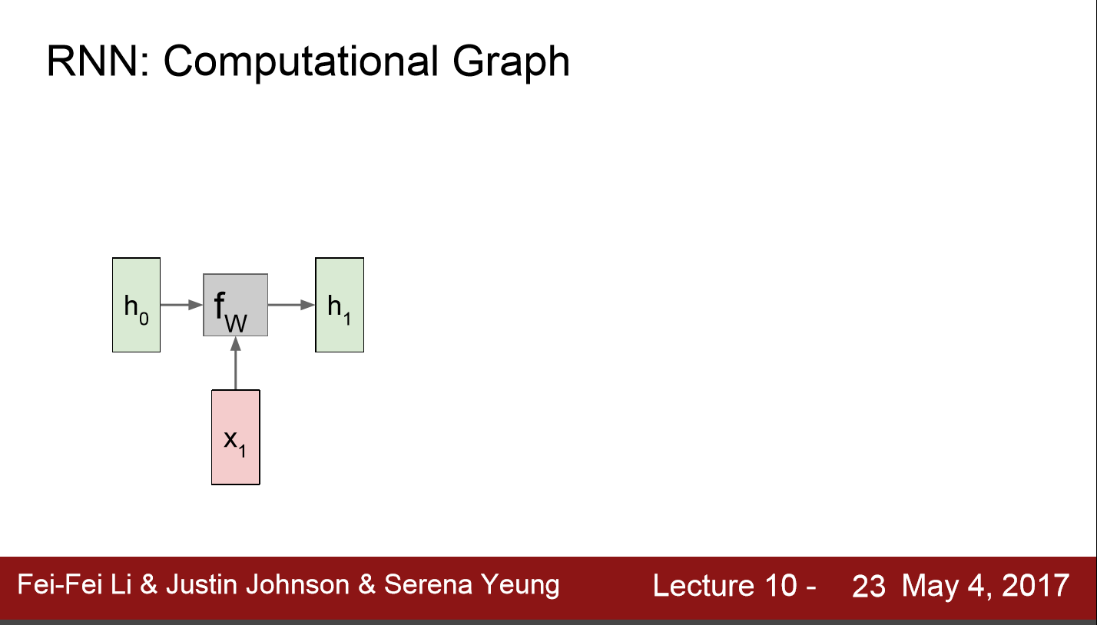
CNTK originally meant Computational Network ToolKit (now it is called the Cognitive Toolkit)

Slide 12
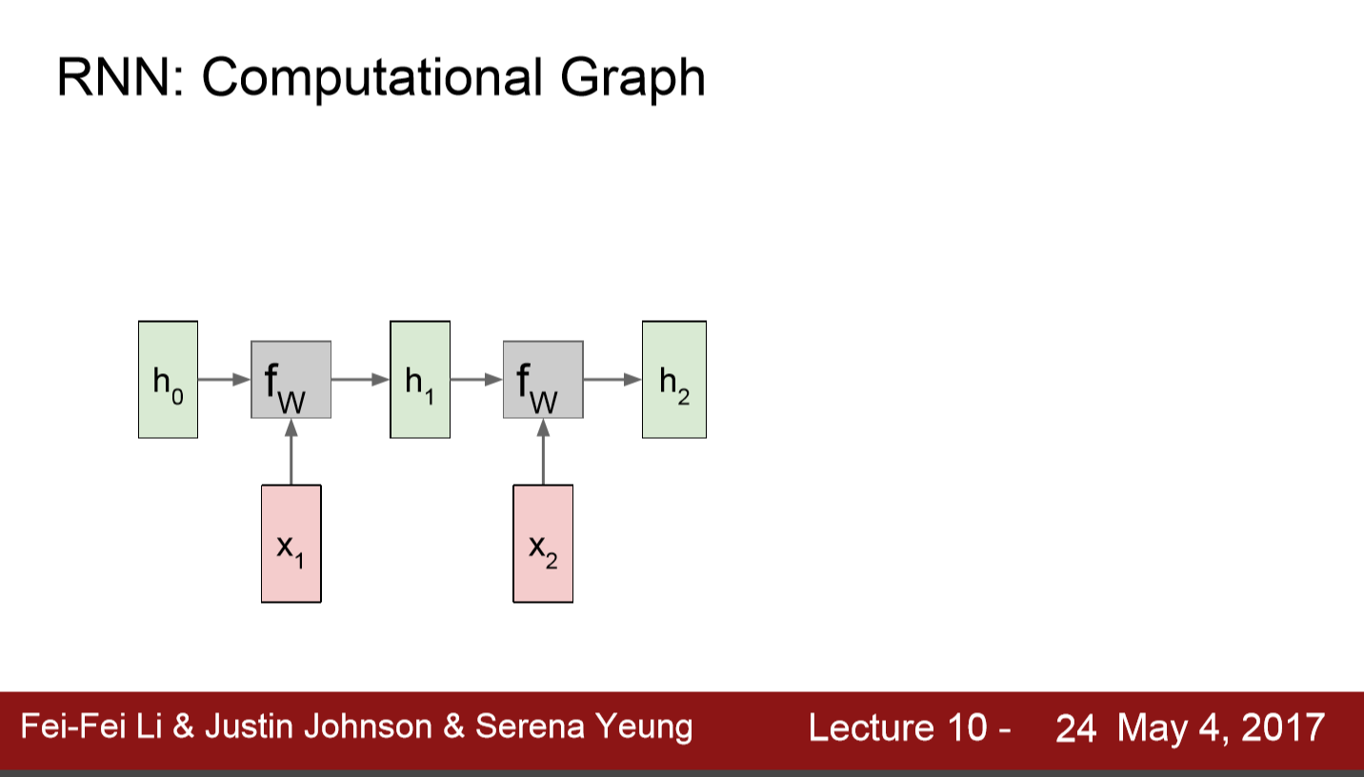

Slide 13
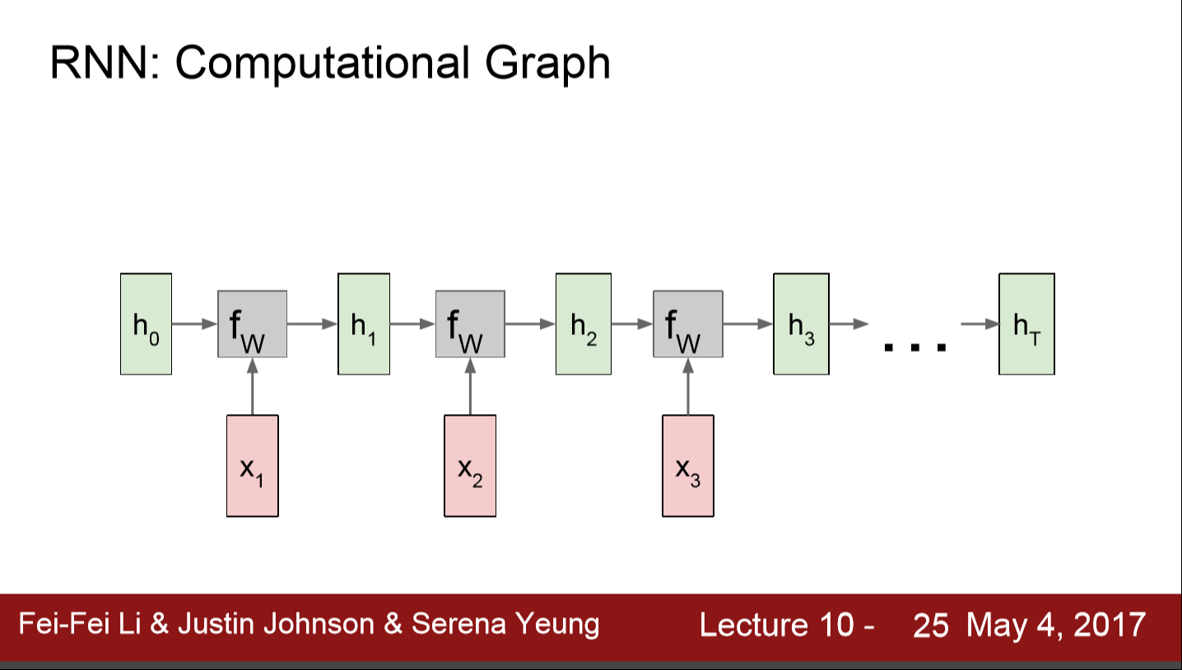

Slide 14
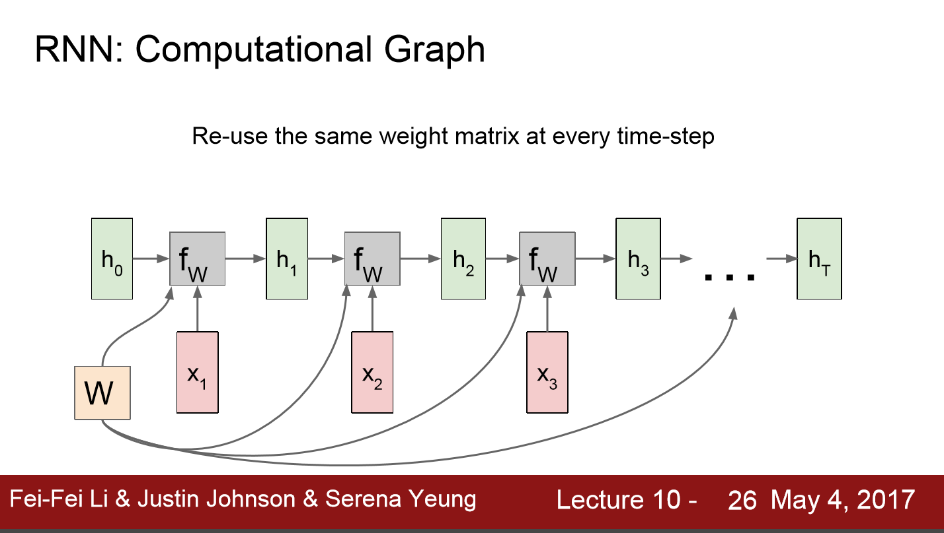

Slide 15
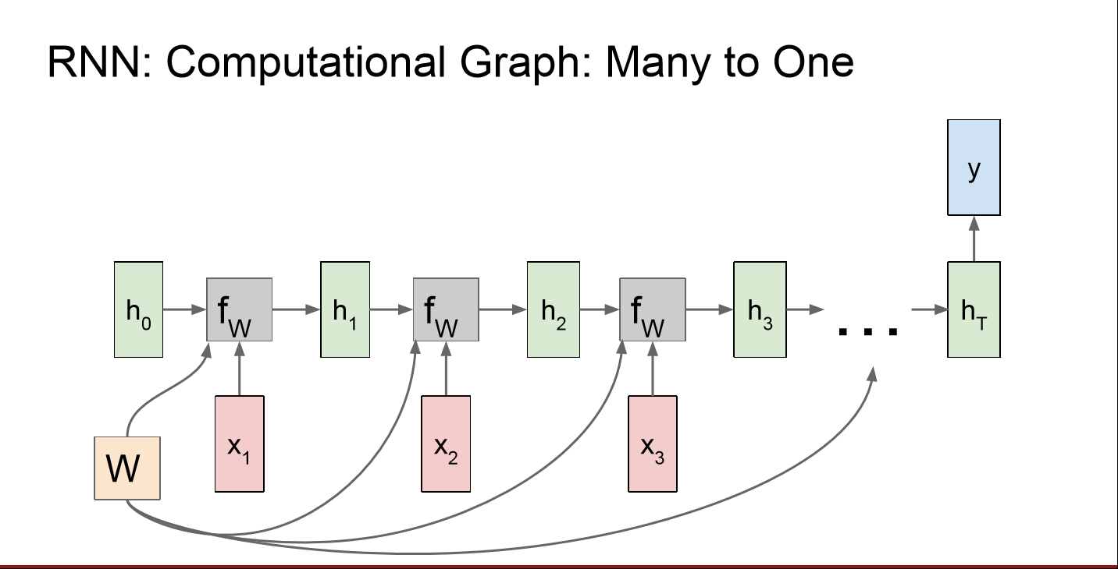

Slide 16
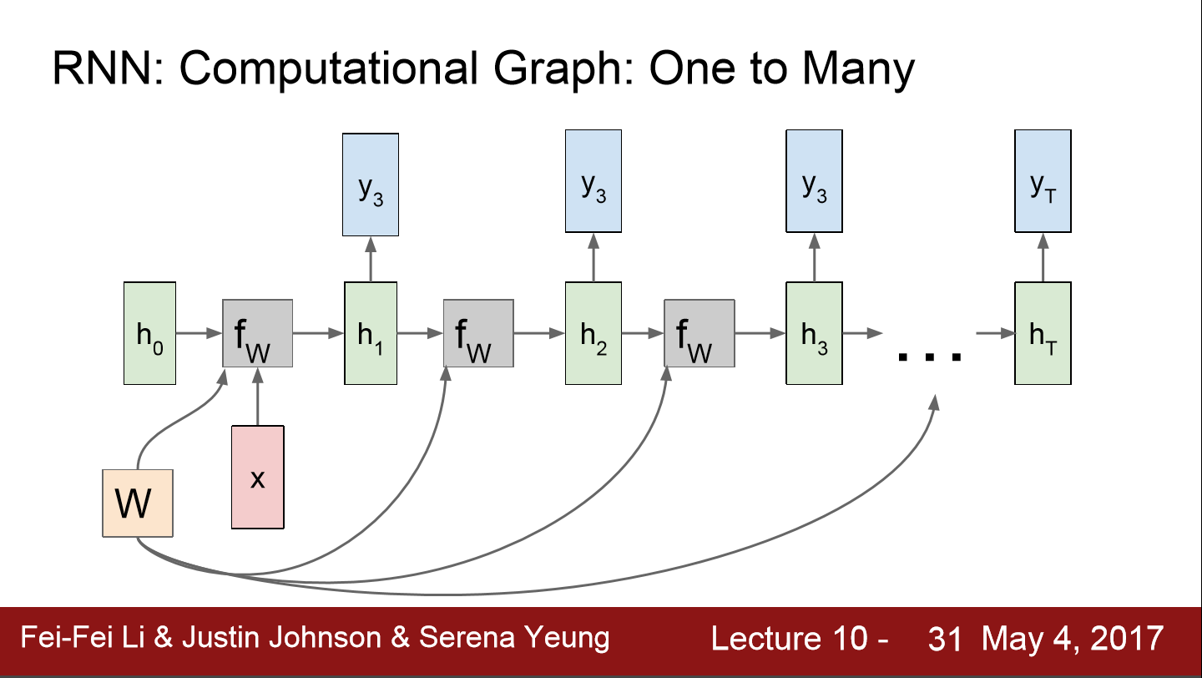

Slide 17
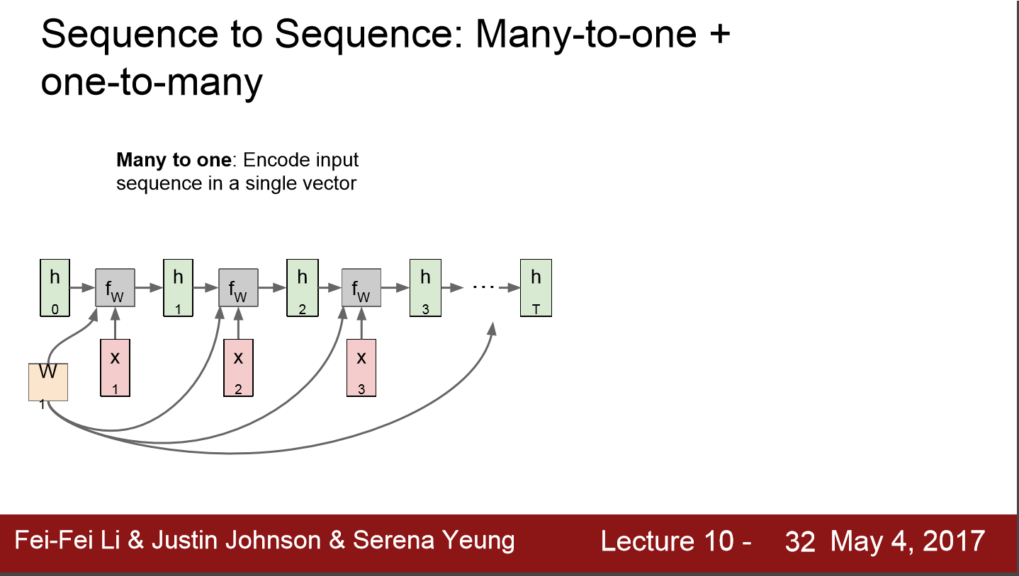

Slide 18
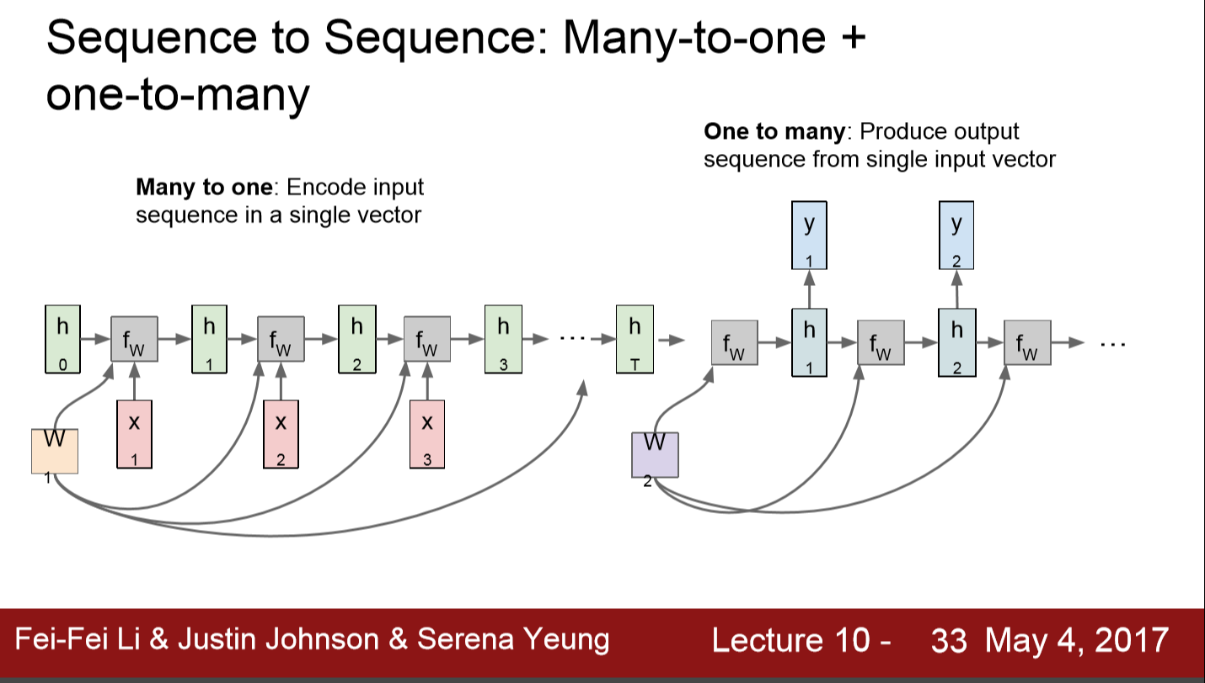

Slide 19
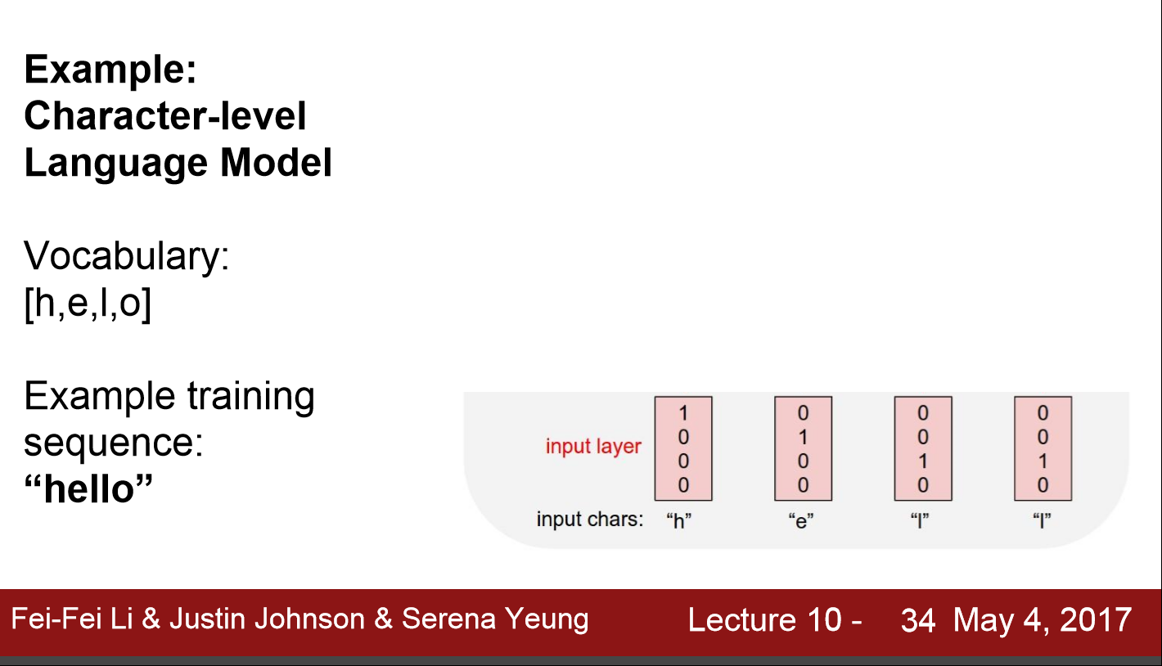

Slide 20
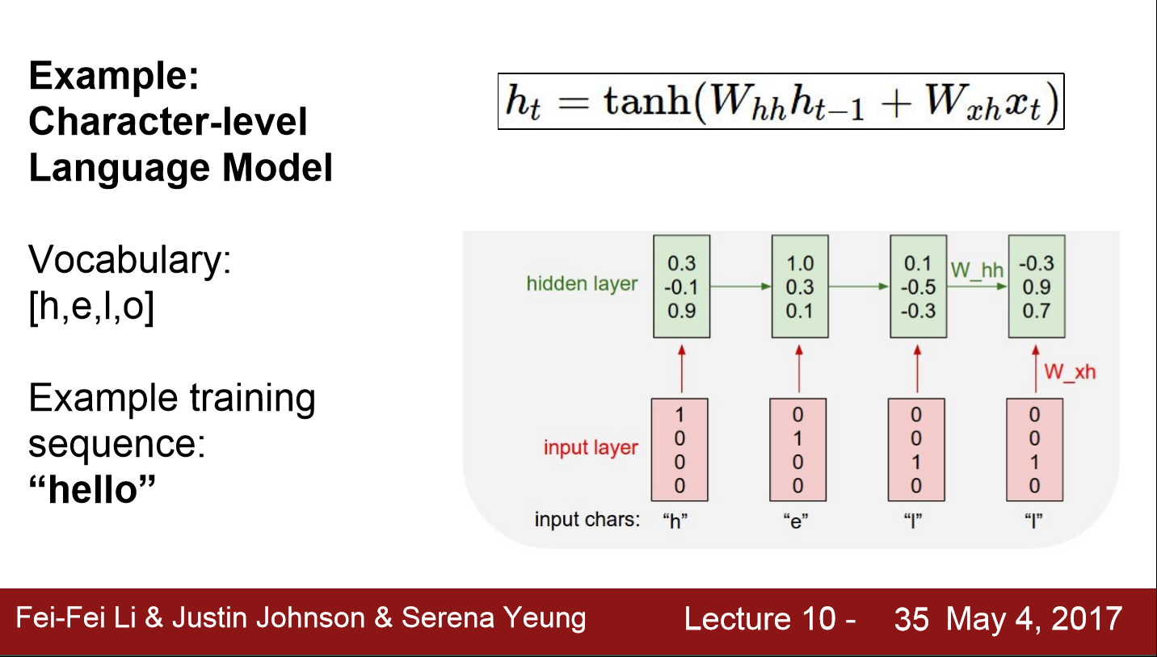

Slide 21
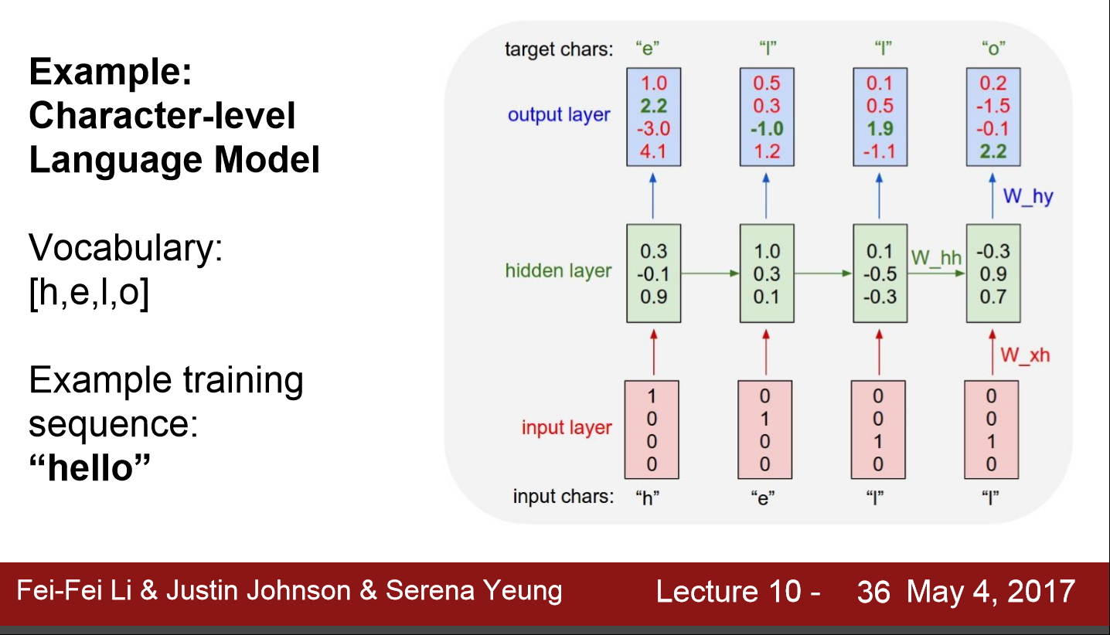

Slide 22
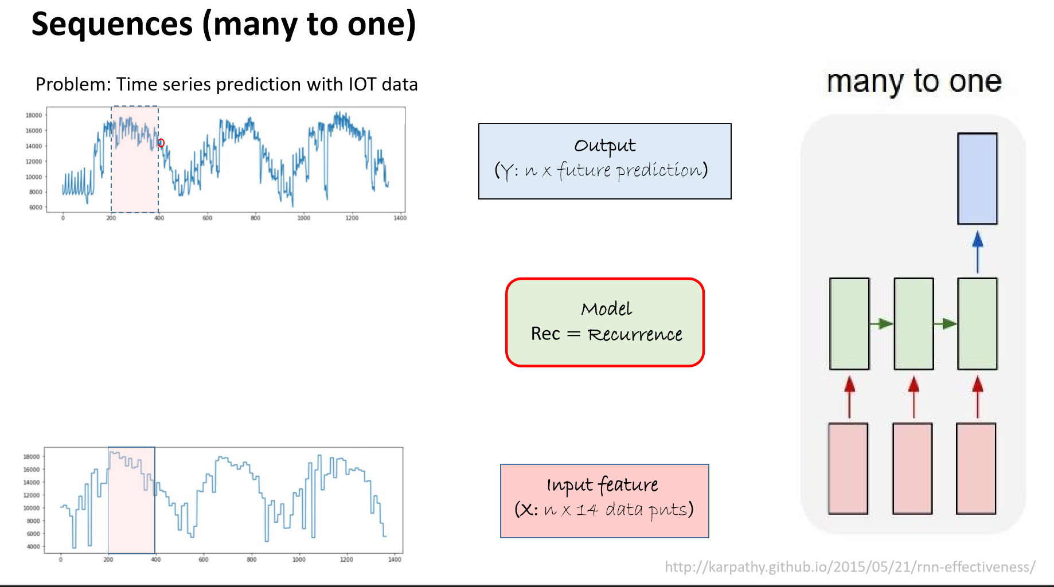

Slide 23
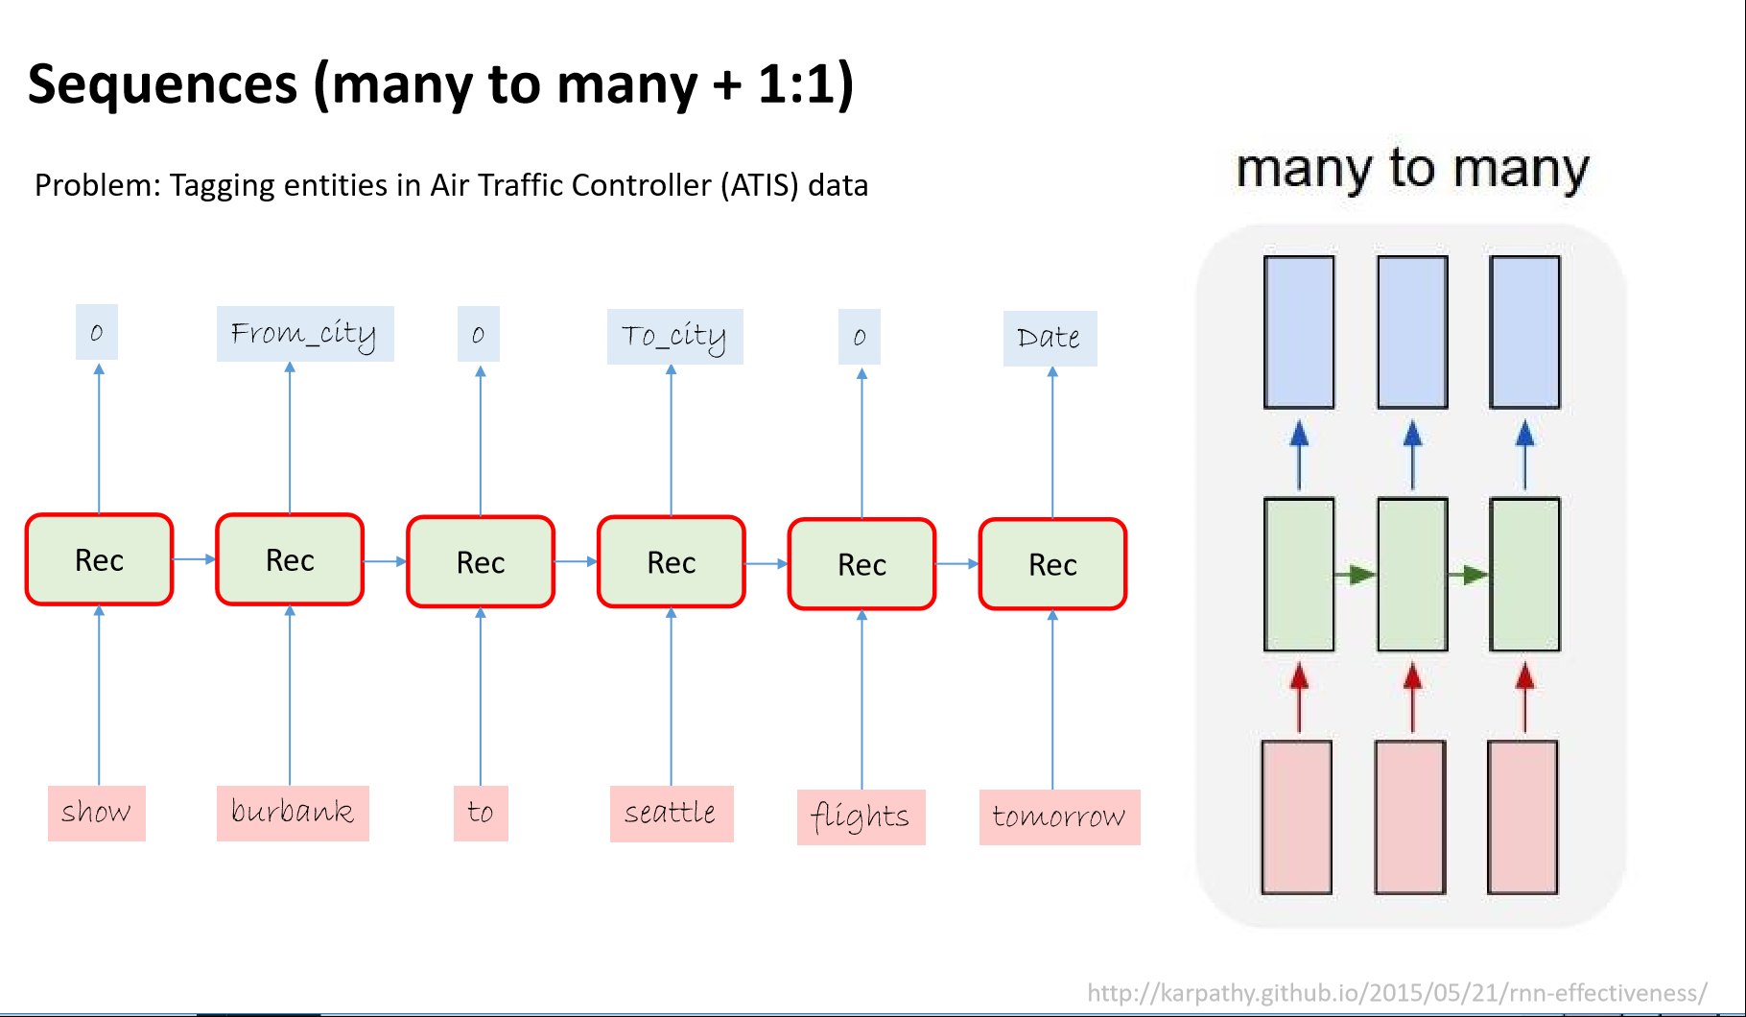

Slide 24
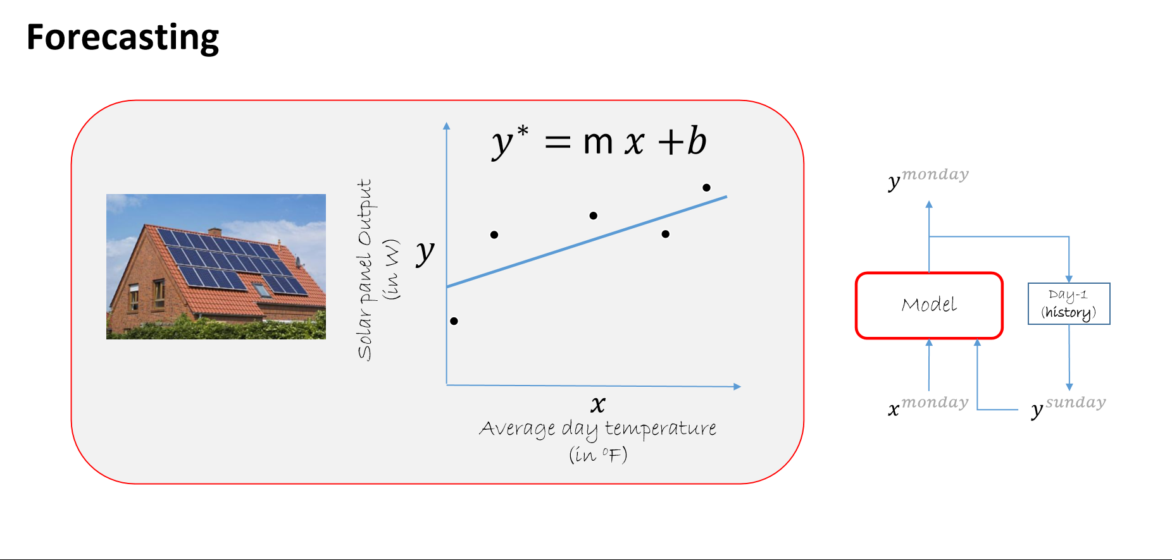

Slide 25
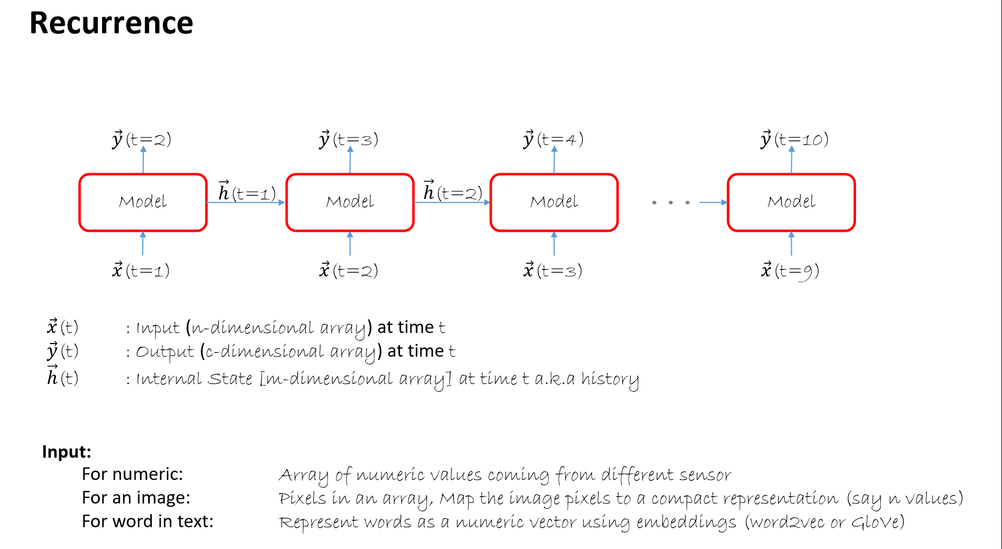

Slide 26
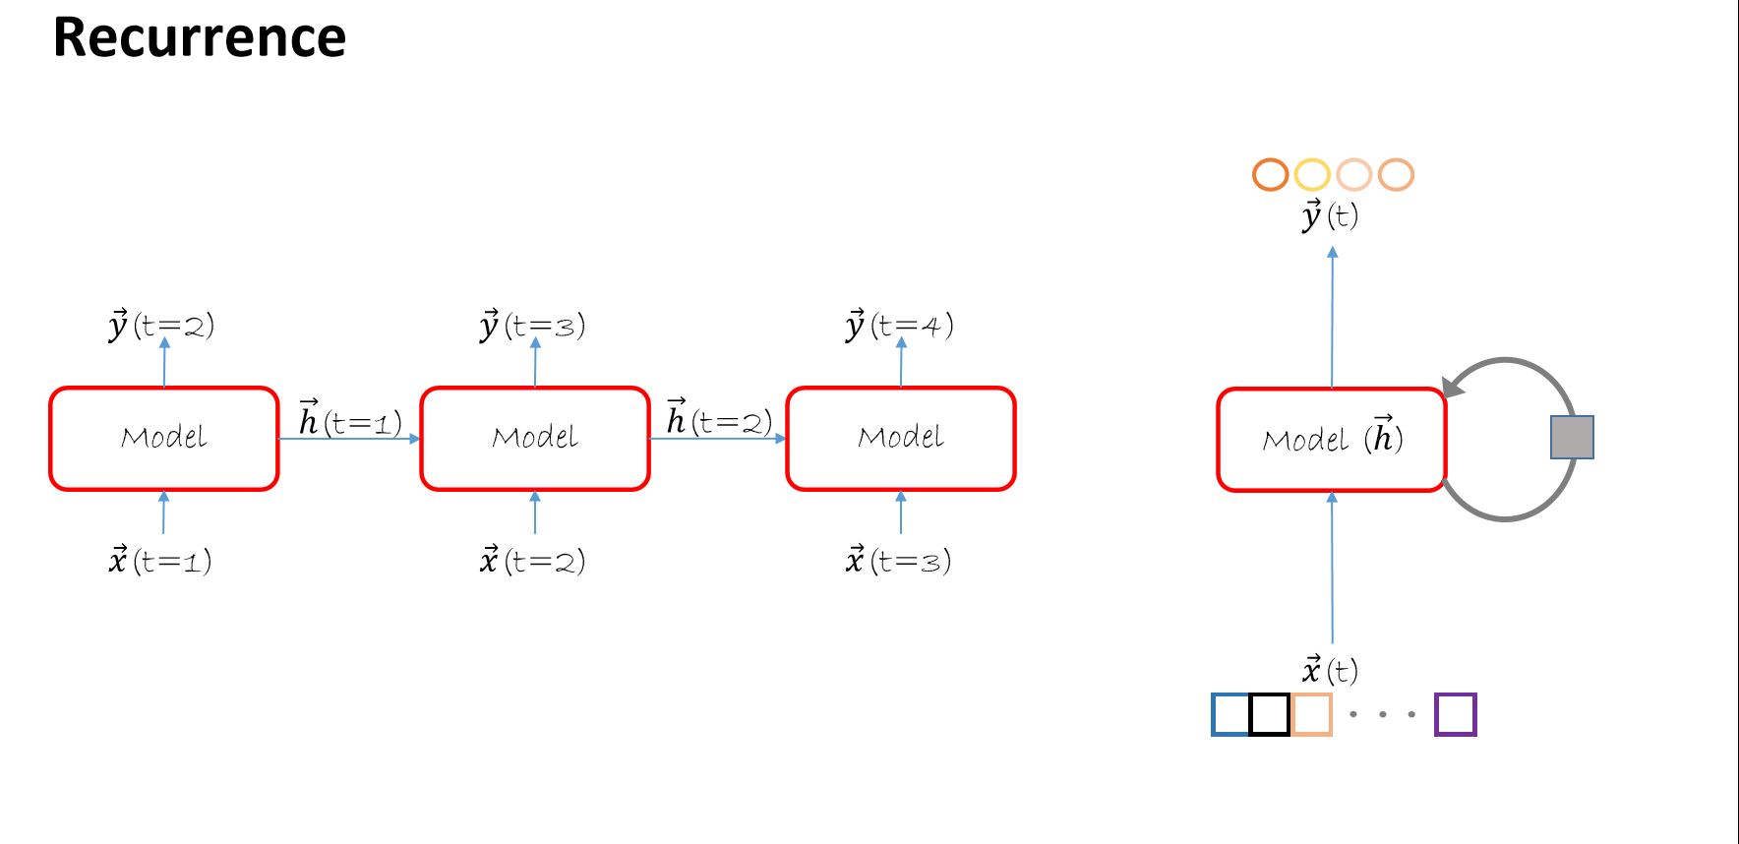

Slide 27
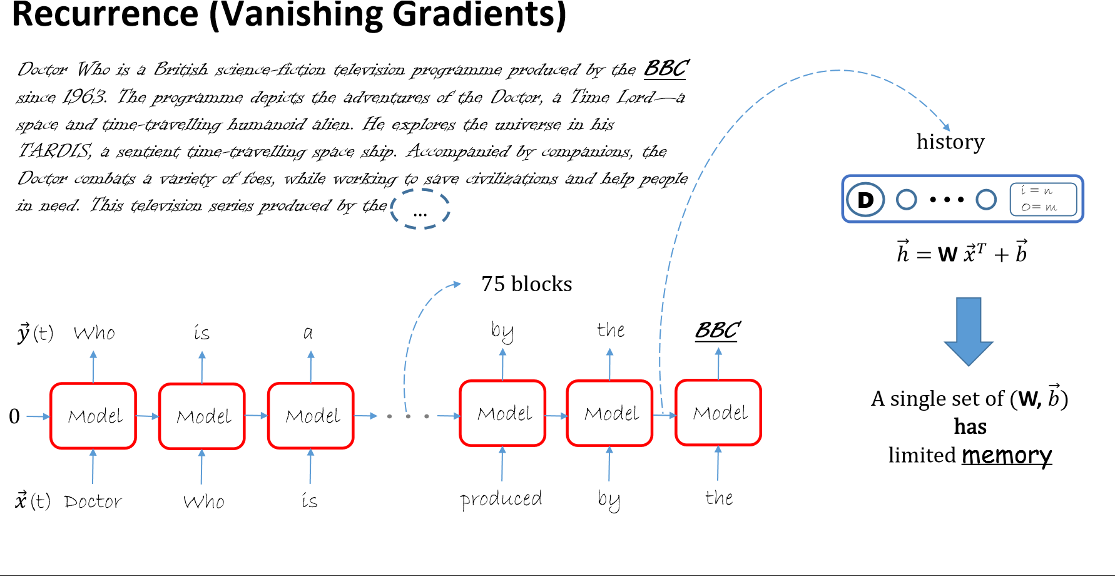

Slide 28
What we need is an LSTM (long short term memory)
LSTM transforms its memory in a very precise way: by using specific learning mechanisms for which pieces of information to remember, which to update, and which to pay attention to.
This helps it keep track of information over longer periods of time.
An LSTM is a specific neural network within the larger RNN network

Slide 29
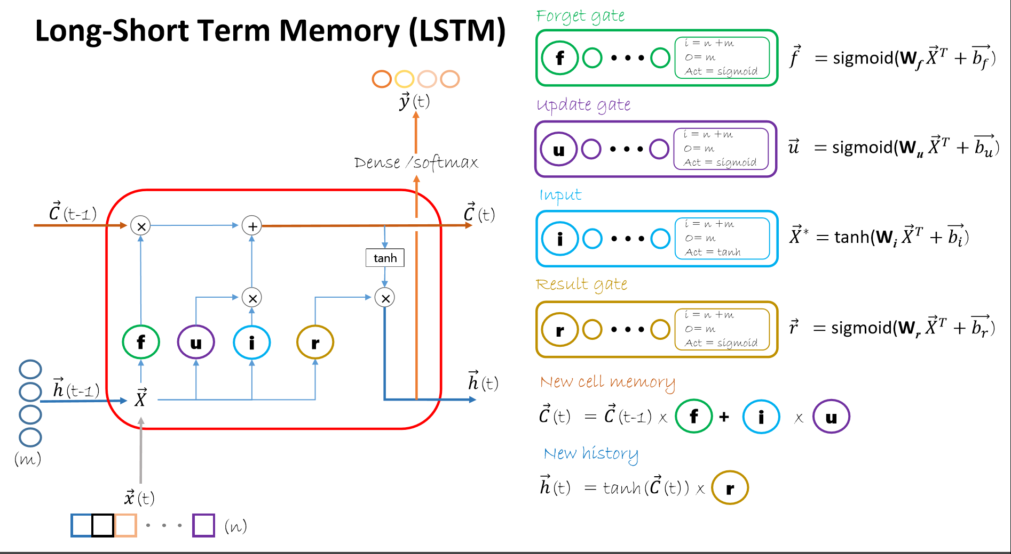

Slide 30
Theory behind prior slide
forgetting/remembering mechanism: when new inputs come in, it needs to know what data to keep or throw away.
saving mechanism. When the model sees a new image, it needs to learn whether any information about the image is worth using and saving
new a input comes in, the model first forgets any long-term information it decides it no longer needs.
Focusing long-term memory into working memory. Finally, the model needs to learn which parts of its long-term memory are immediately useful.
https://www.topbots.com/exploring-lstm-tutorial-part-1-recurrent-neural-network-deep-learning/

Slide 31
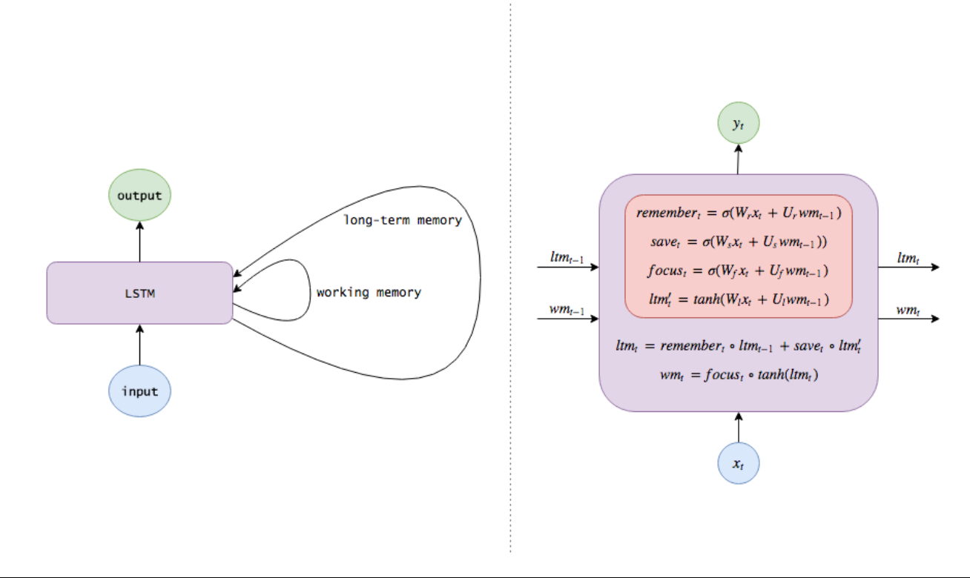
Logical Actual
https://www.topbots.com/exploring-lstm-tutorial-part-1-recurrent-neural-network-deep-learning/

Slide 32
Let’s build a simple RNN/LSTM
Goal – model and predict the values of a sine wave
Use ‘N’ prior observations to predict ‘M’ future values
Learn (train) by using an RNN with an LSTM – the LSTM can handle 5 values
Our prediction will be a single output value so our final layer must be a single node

Slide 33
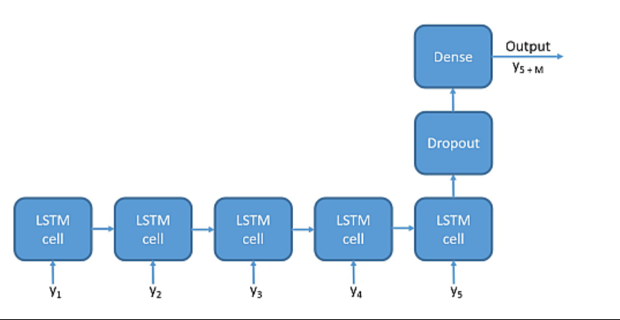
For our time series simulation we want to build

Slide 34
How do I construct RNN/ LSTM in CNTK?
Parameters
step_function: the Function to recur over, for example LSTM()
def create_model(x):
"""Create the model for time series prediction"""
with C.layers.default_options(initial_state = 0.1):
m = C.layers.Recurrence(C.layers.LSTM(N))(x) #recurrent layer of ‘N’ LSTM #cells ‘x’ is the shape of #the input data
m = C.sequence.last(m) #return last element of its input – an append step
m = C.layers.Dropout(0.2, seed=1)(m) #prevent overfitting
m = C.layers.Dense(1)(m) #one output value a layer of 1 node – one #prediction point on the curve
return m #m is the model
#bear in mind C.layers calls often return a function - why the ‘x’ and ‘m’ are appended
https://github.com/jimwill3/NY-AZML-Meetup/blob/CNTK/RNNLSTM1026.ipynb
https://www.cntk.ai/pythondocs/layerref.html#recurrence

Slide 35
Continue with LSTM node
LSTM(shape,
cell_shape=None,
activation=default_override_or(tanh), use_peepholes=default_override_or(False),
init=default_override_or(glorot_uniform()), init_bias=default_override_or(0), enable_self_stabilization=default_override_or(False),
name=‘LSTMnamehere’)
!!! To simplify – the only mandatory parameter is the shape parameter which must be…the number of LSTM cells
The shape of the OUTPUT dimension – in our sample (prior page) it was the value of ‘N’. In our demo code ‘N’ is 5 representing 5 steps in the sequence we use as our input. The LSTM takes in 5 values and outputs 5 values (the default for cell_shape is to assume the value of shape).
https://www.cntk.ai/pythondocs/layerref.html

Slide 36
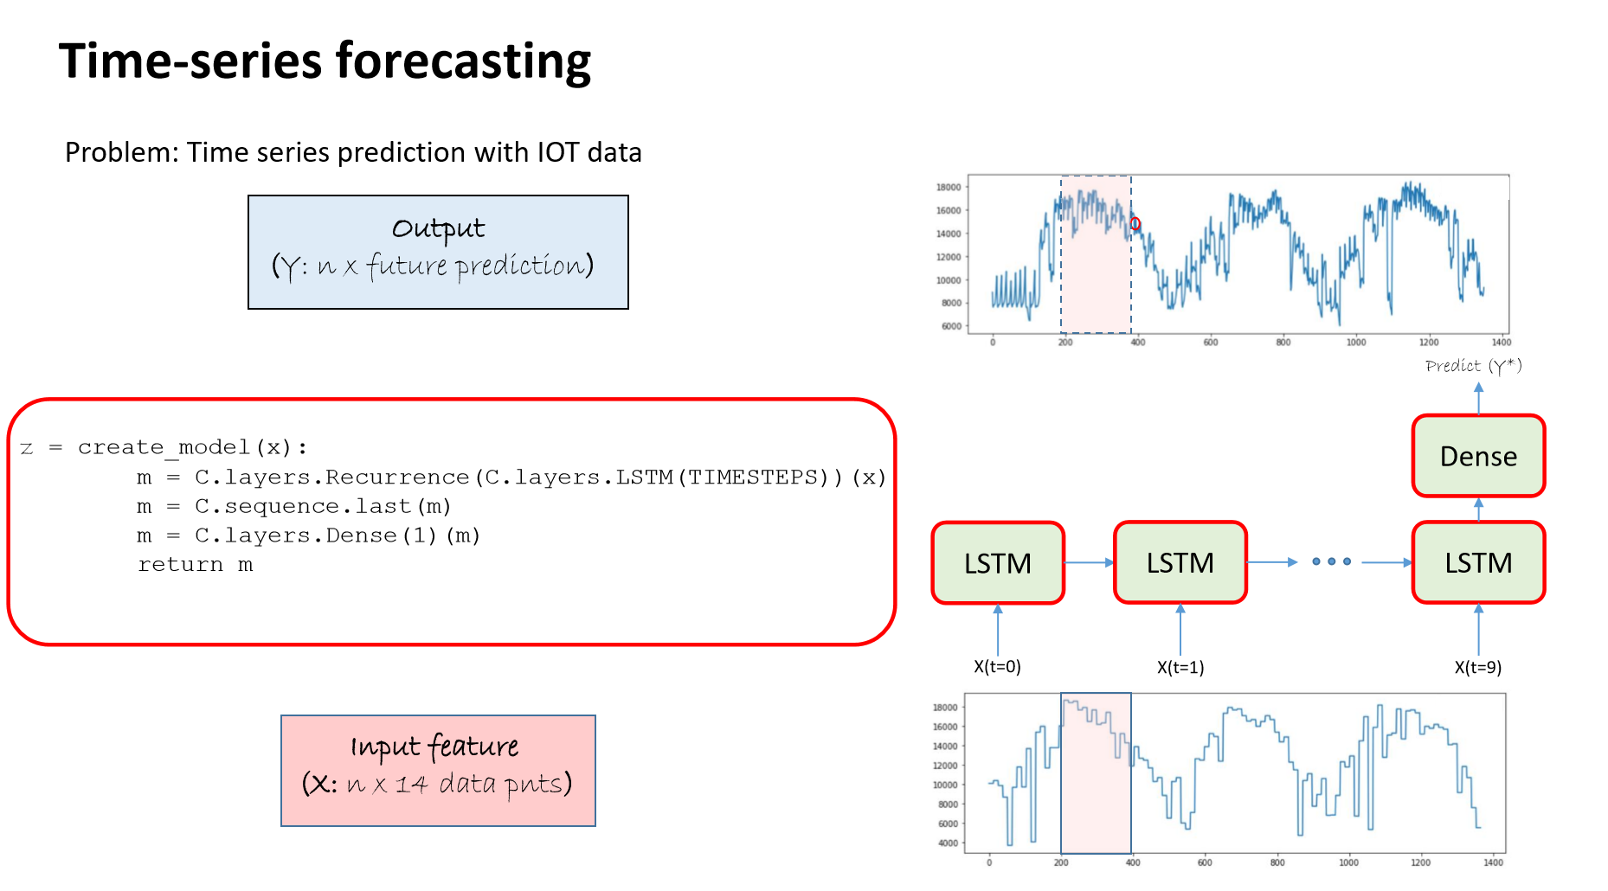

Slide 37
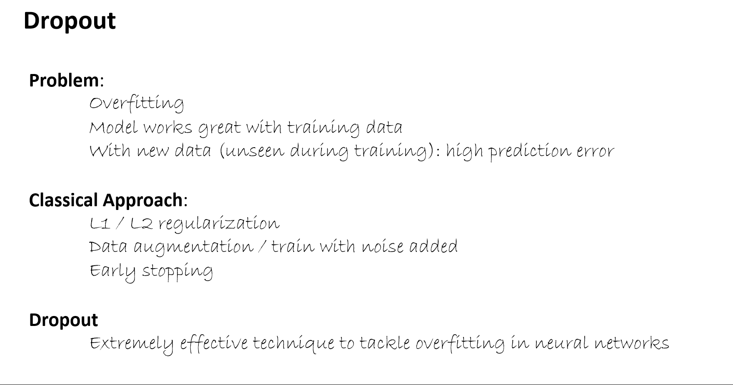

Slide 38
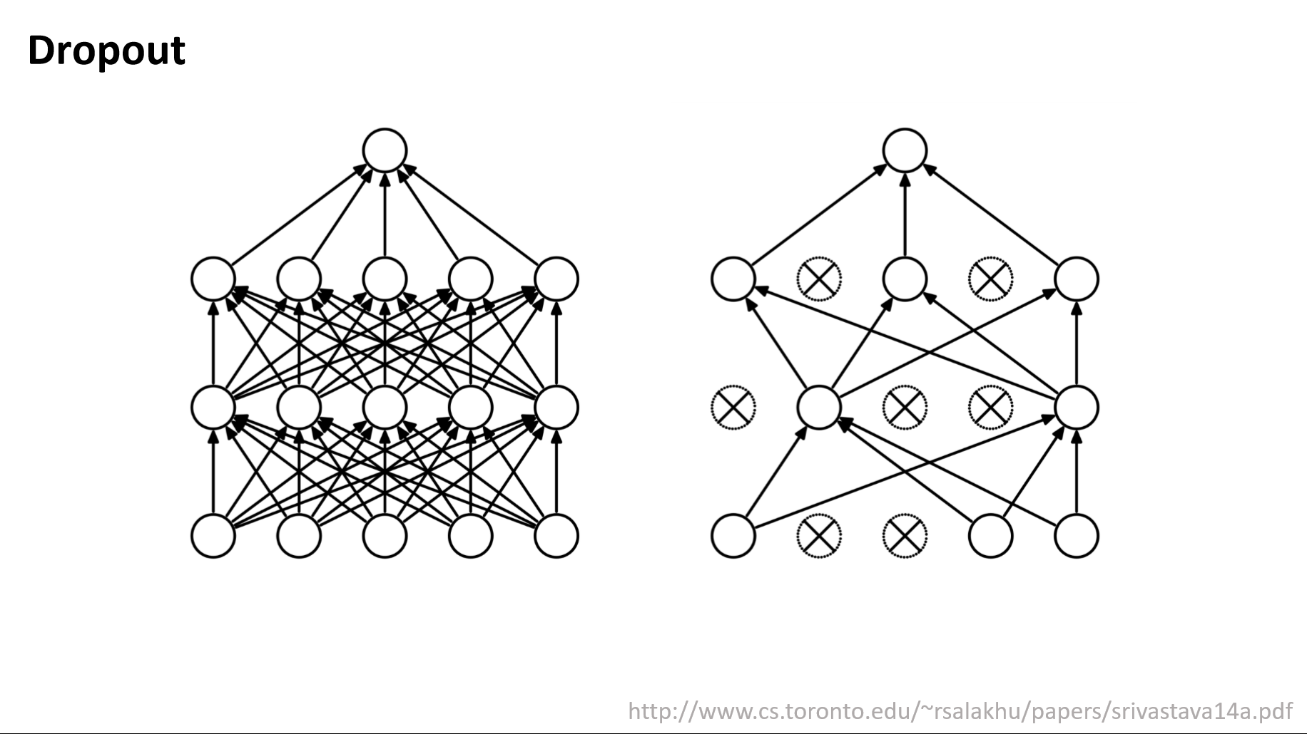

Slide 39
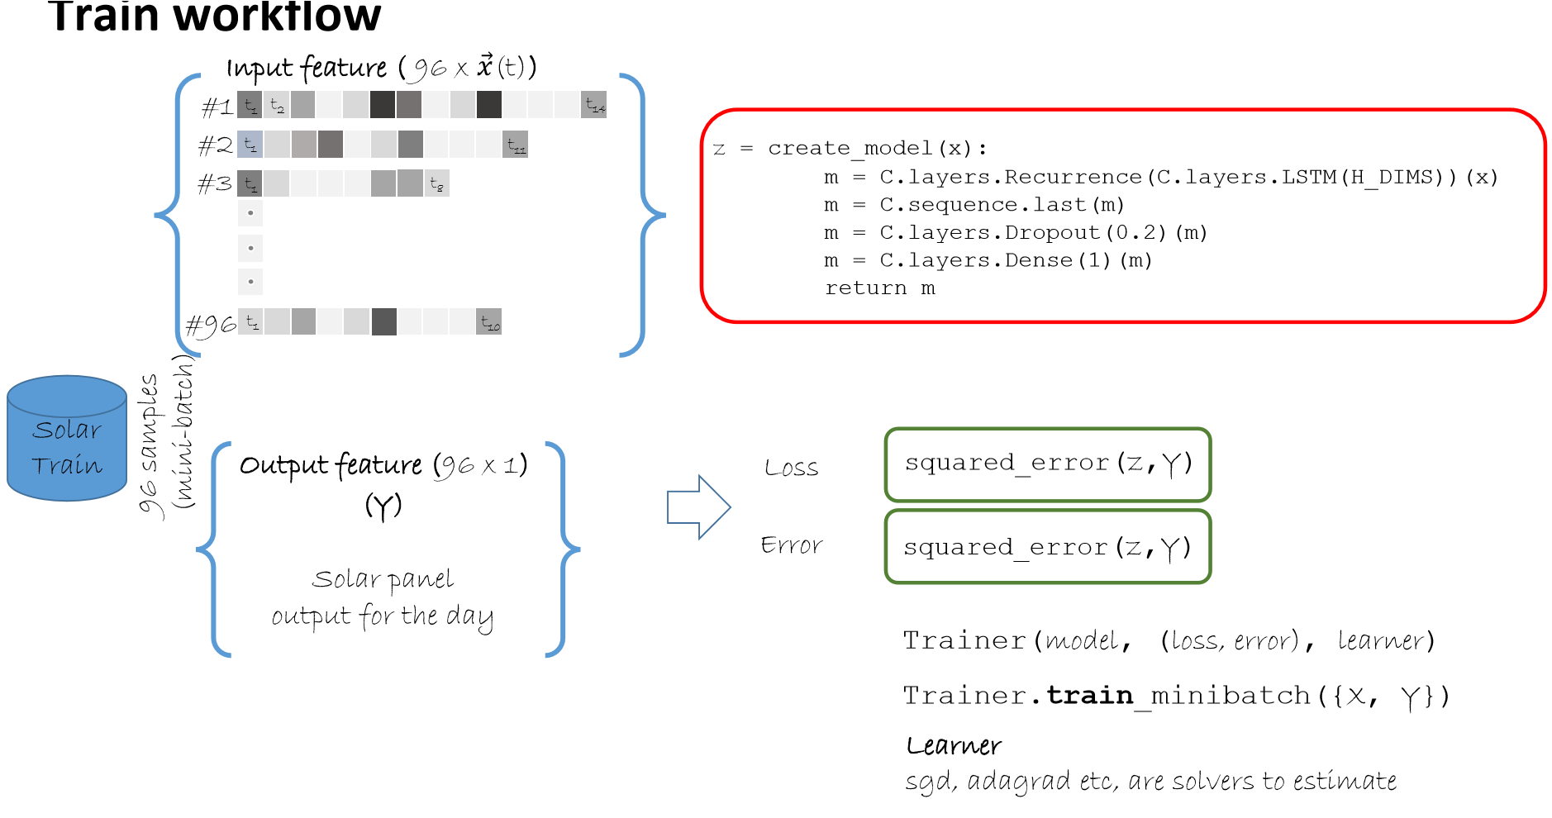

Slide 40
Sources
https://azure.microsoft.com/en-us/blog/deep-learning-for-predictive-maintenance/
You can try your own DSVM (data science virtual machine) – see
http://aka.ms/dsvm
You can try Azure notebooks (azure hosted jupyter notebooks) for free at:
http://Notebooks.azure.com
create a new empty notebook and upload this file:
https://github.com/Microsoft/CNTK/blob/master/Tutorials/CNTK_106A_LSTM_Timeseries_with_Simulated_Data.ipynb

